Slide 1

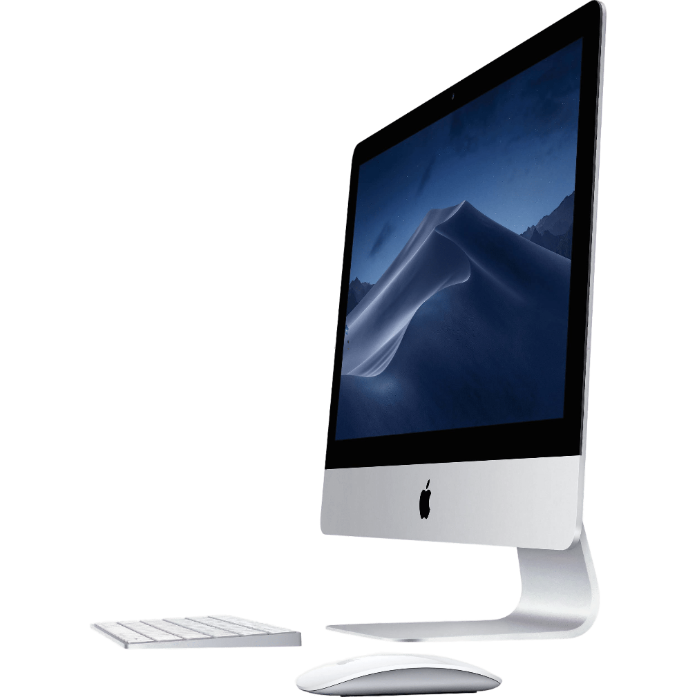
Institute of Information Technology
What is a Computer?
By George Belik
3rd year student,
information Systems Department

Slide 2
Before we start, we will analyze 3 main parts:
Devices
Display
Operating systems

Slide 3
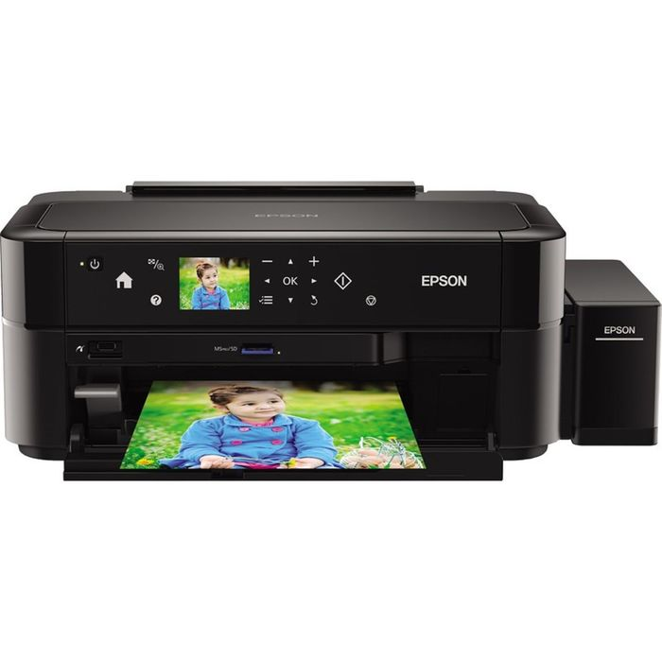
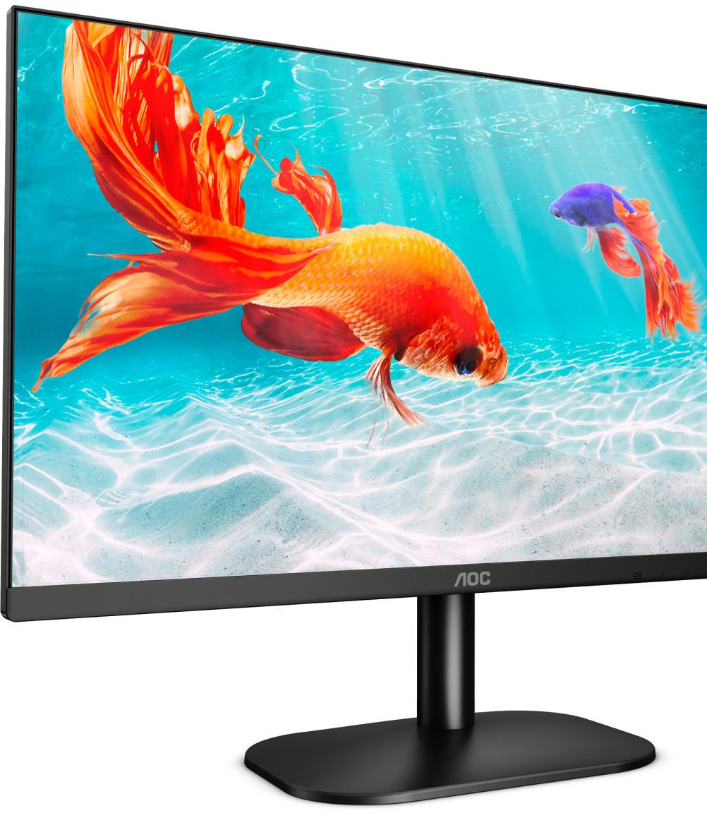
Output Devices

Slide 4
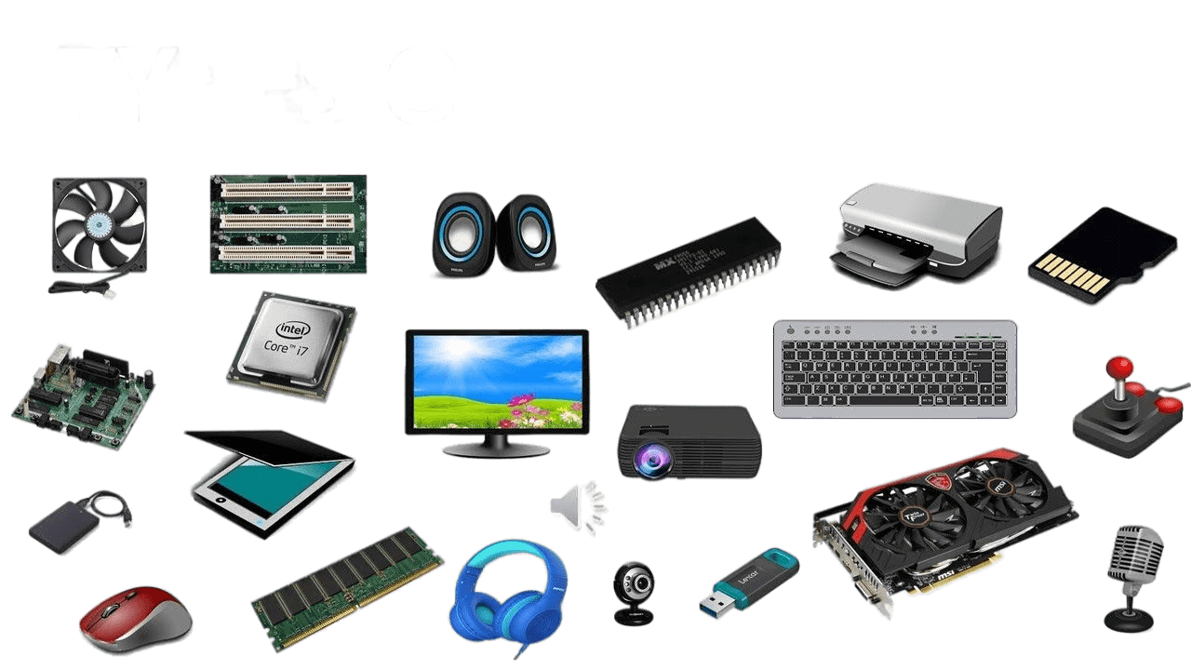
Hardware is any electronic or mechanical part you can see or touch

Slide 5
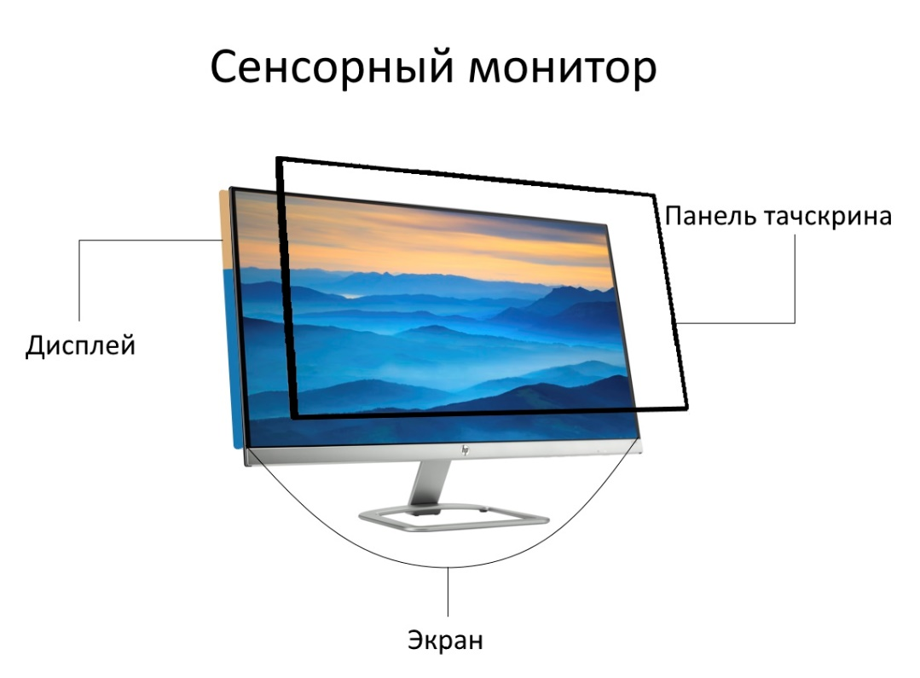
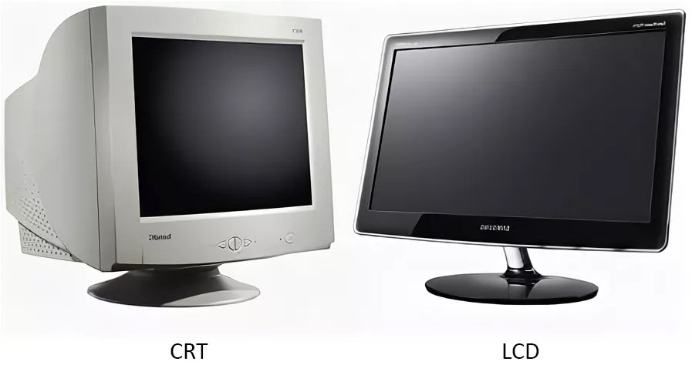
How screen displays work?
Displays provide instant feedback by showing you text and graphic images as you work or play.

Slide 6

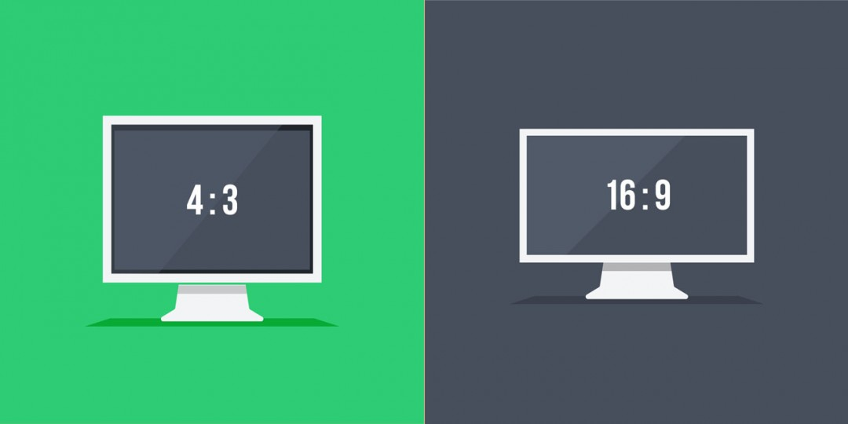
Basic features
Resolution
Aspect ratio

Slide 7
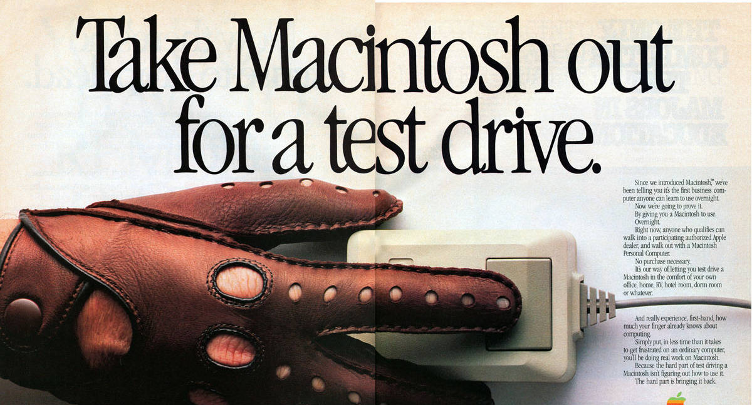
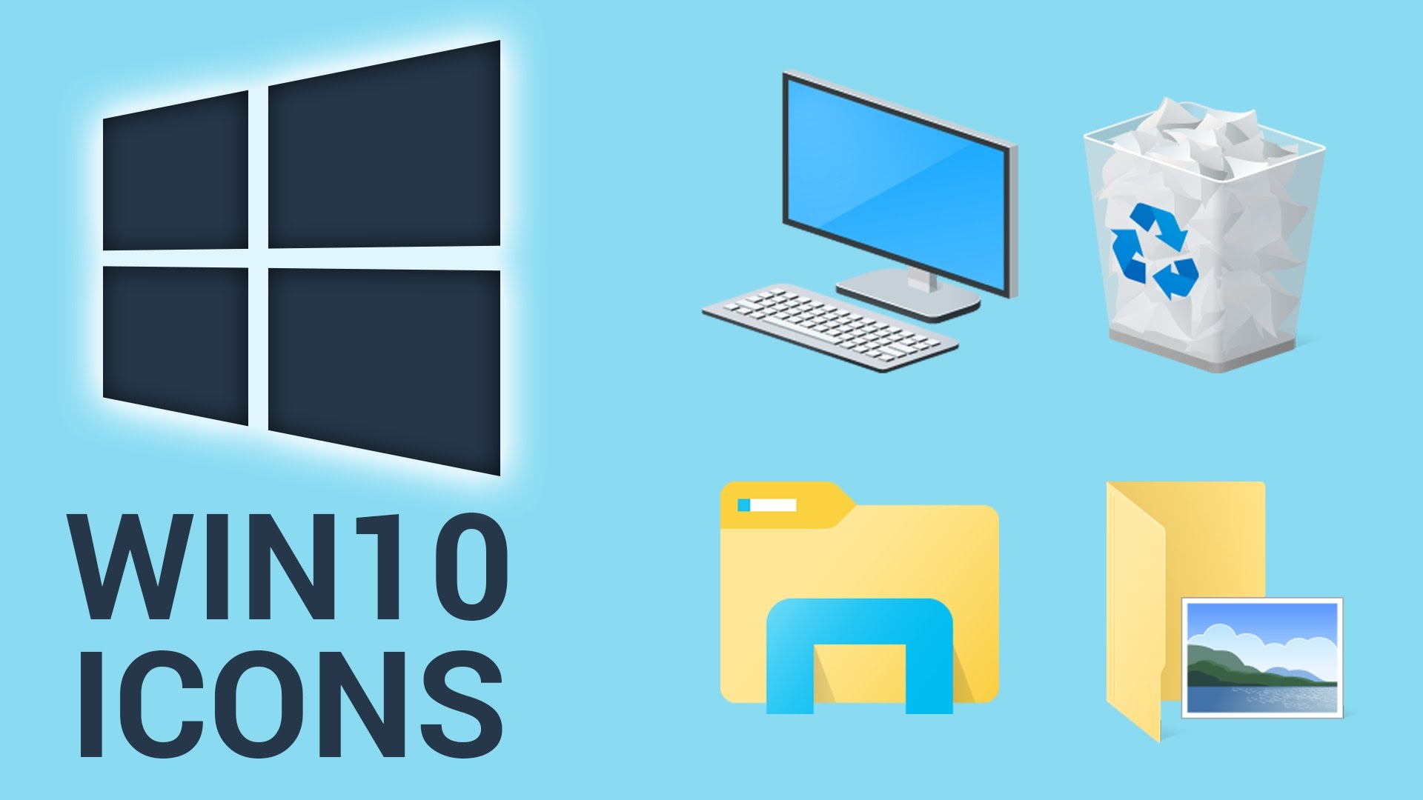
GUI operating systems
Graphical User Interface (GUI)

Slide 8
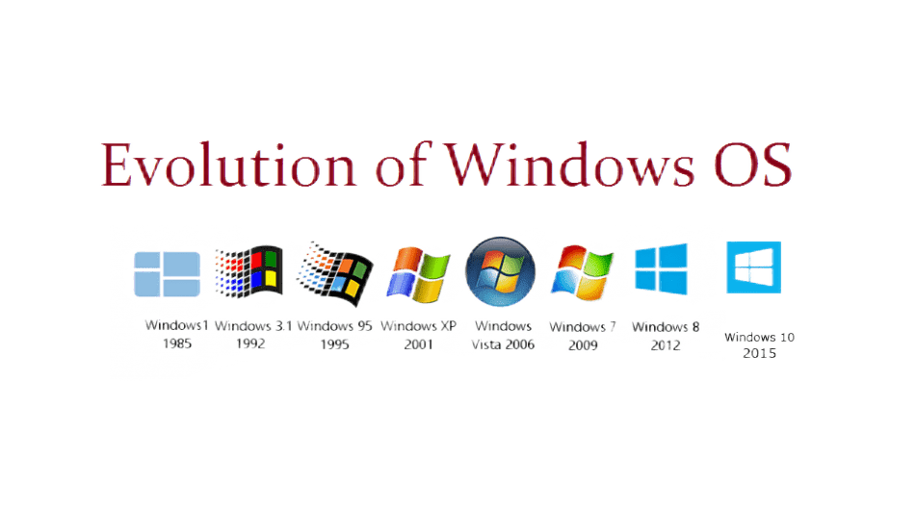
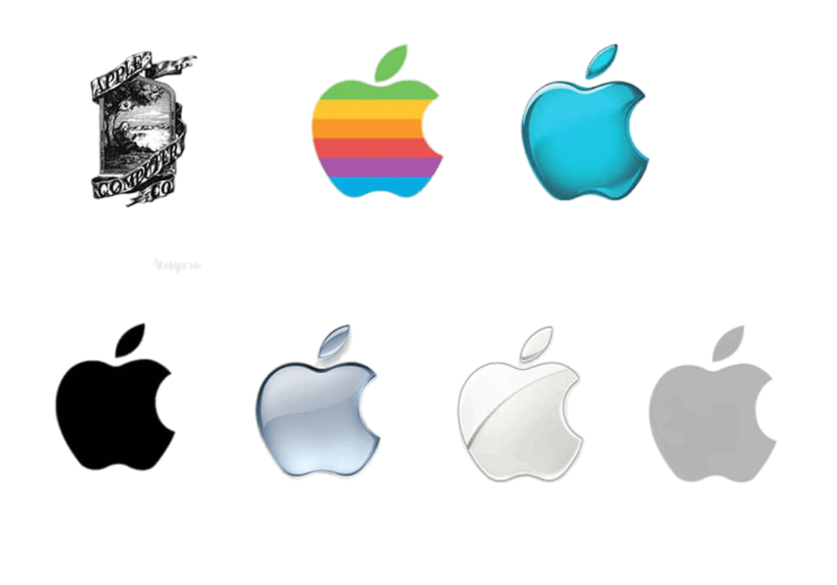
Most popular PCs OS Evolution
Windows
MacOS

Slide 9
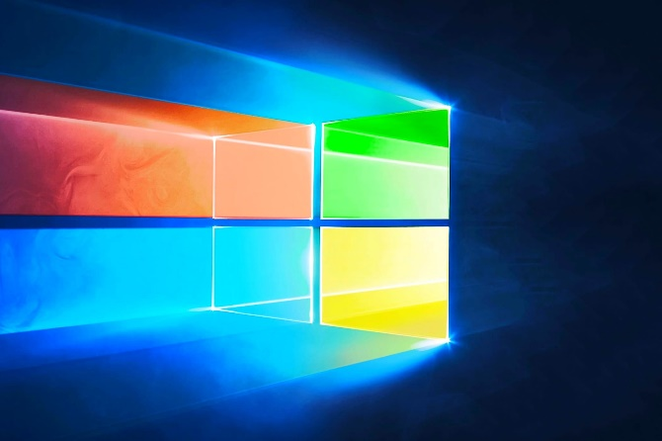


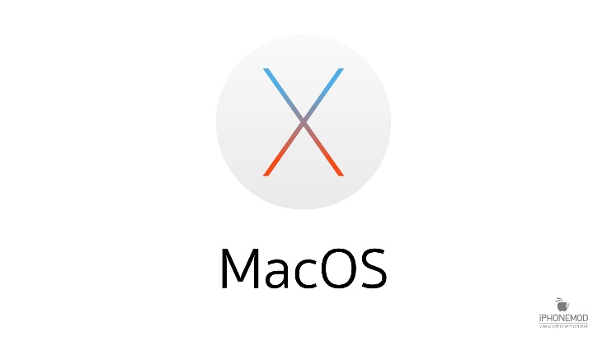
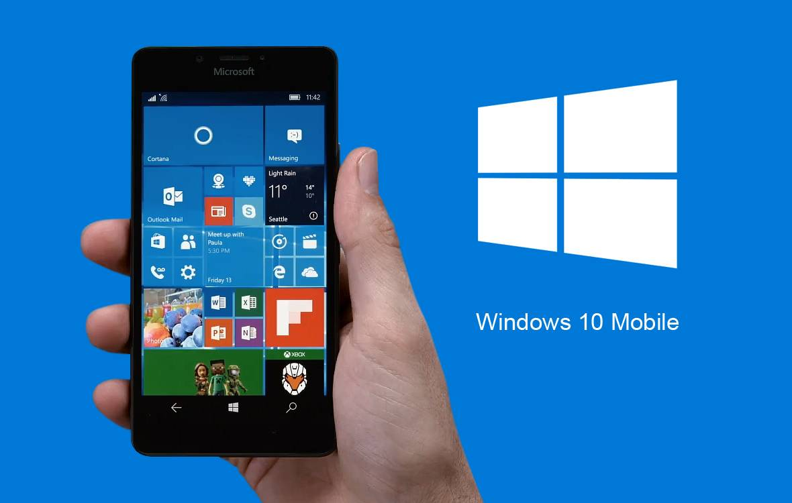

The most popular operating systems are:

Slide 10
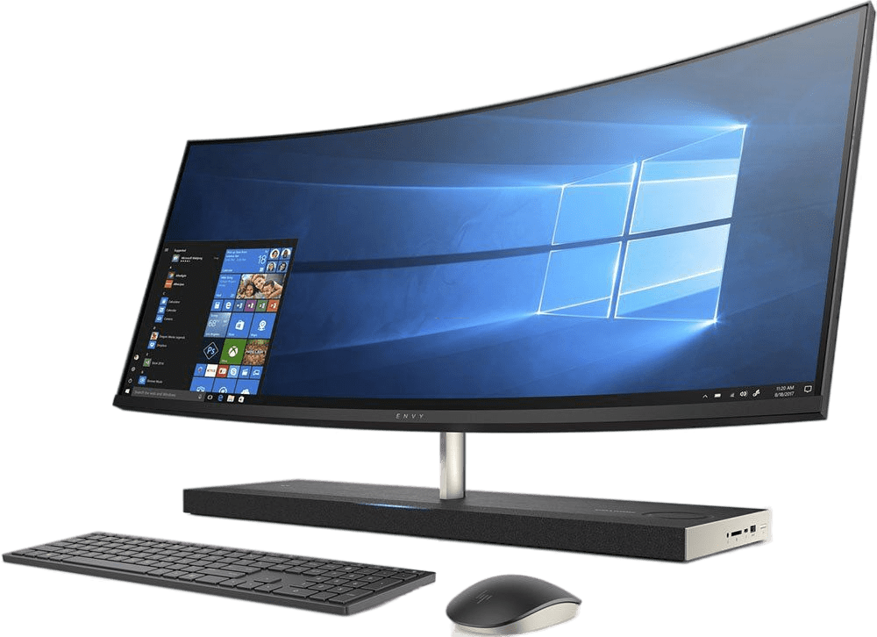
Thank you for your attention

